Slide 1
Java Programming Structure

Slide 2
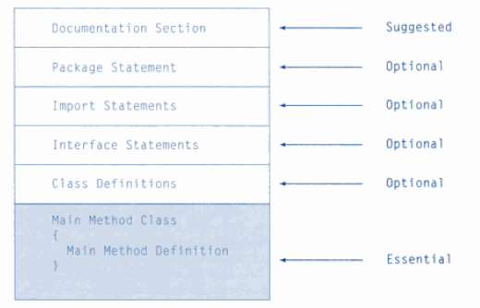
Java Programming Structure

Slide 3
Simple Java Program
public class Countdown
{
//-----------------------------------------------------------------
// Prints two lines of output representing a rocket countdown.
//-----------------------------------------------------------------
public static void main (String[] args)
{
System.out.print ("Three... ");
System.out.print ("Two... ");
System.out.print ("One... ");
System.out.print ("Zero... ");
System.out.println ("Liftoff!"); // appears on first output line
System.out.println ("Houston, we have a problem.");
}
}

Slide 4
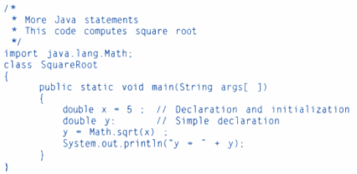
Simple Java Program

Slide 5
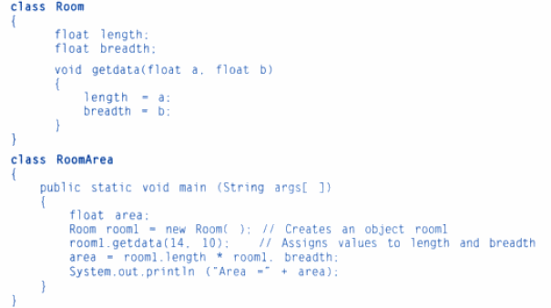
Simple Java Program

